Slide 1
How To Effectively Conduct Virtual Admissions by The Art of Admissions www.TheArtofAdmissions.com
Innovations in Virtual Admissions

Slide 2
Benefits of Virtual Interviewing & Tours
There are many benefits to virtual interviewing and tours. Some of these include:
Unlike a phone interview, you can read body language
Easier to find a time for the appointment
Multiple parties can participate on the session
It is way more connecting and personal than phone
It increases the status of representative

Slide 3
Potential Issues with Virtual Interviewing
There potential issues that can arise using virtual interviewing and tours that can hurt conversion rates. Some of these include:
Both you AND the Explorer need a good internet connection,
You need a quality webcam and microphone.
Lack of technology savvy & problems connecting
Bad lighting, unprofessional backgrounds and background noise
Untrained reps can come across poorly on video
Not having a solid process or framework for the team to work
Admissions representatives may be initially uncomfortable

Slide 4
Virtual vs. Phone Interviewing & Tours
Video has a tremendous amount of benefits vs. phone interviews only.
Your admissions representative’s face, voice, personality, expertise, enthusiasm and all those other uniquely human and subconsciously processed social cues are delivered far better in video than through a traditional phone call.
Video ends up creating a way more powerful personal connection much more quickly, as well as much more inspiration, excitement and enthusiasm for prospective students to explore their possibilities!

Slide 5
Virtual Interview Structures for Success
The remote Career Planning Sessions (CPS) pose additional challenges for the school and requires a well thought out plan including the 4 core structures:
Technology – What is needed to conduct high-quality CPS
Tactics – Having a specific online process and framework
Technique – How the rep should talk, act and come across
Training – Practice & Role-Play with your team to make it second nature

Slide 6
Technology

Slide 7
Virtual Interview Technology
The Career Planning Session (CPS) is an emotion-based process designed to lead the Explorer through a journey of discovery. When done remotely, technology plays a critical role in helping establish an authentic connection.
Laptop computer with embedded webcam
External webcam or camera
Quality noise cancellation headset or microphone
High-Speed and stable Internet connection
An easy-to-use video & screen sharing platform

Slide 8
Screen Share / Communication Platform
A key to conducting a great virtual interview and tour is having a platform that is easy to use for BOTH the rep and Explorer. Some strong platforms are:
Recommended: www.Zoom.us (Requires mobile app download)
www.Gruveo.com (No mobile app download required)
Others: Startmeeting, Uberconference, Join.me, etc…
Test them out and make sure your team is trained on their use

Slide 9
Tactics

Slide 10
Career Planning Session Structure
The Career Planning Sessions (CPS) should be organized into a clear step-by-step process designed to lead the Explorer though their journey of discovering their possibilities.
Arrival & Greeting – Arrival, Greeting, Agenda, Intention
Discovery - Uncover their WHY, their needs, their motivation
Presentation & Tour - Build immense value & INSPIRE them
Proposal - What the INVESTMENT in their future will cost
Bridge - Transition to the application
Application – Handle objections, application
Follow Up - Set next steps, follow up & nurture

Slide 11
The Virtual Tour Difference
There are a few key changes to our Career Planning Session when going virtual vs. ground.
The time must be shorter (25-30 minutes max)
Use a shorter Discovery Questionnaire
Use a short PowerPoint or “About Us” visuals
Use a short video virtual tour
Highly recommended: Short 20 to 30 second video testimonials of students, graduates and employers.

Slide 12
The Virtual Tour
Have a scripted virtual/video tour that builds value. Key features of a tour:
Signature Stops
Instructor Wall
Career Services / Career Board
Classroom / Labs
Student Services
Resource Center
(No sound on video is best so the rep can narrate, start & stop)

Slide 13
Creating The Virtual Tour
Filming videos on your phone can often be hit-or-miss. Here’s a handful of simple tips to improve your handheld video, and get a great looking virtual tour of your school.
Horizontal, Not Vertical
Auto-Exposure turned on
Body Points of Contact – Limit body movement
Color Balance – Auto White Balance
Mic & Camera Finger Placement – Don’t cover
Slow pace, show everything, pan slowly when needed, show key items (walls, pics, posters, people) - 60 fps
www.animoto.com for slide-based tour

Slide 14
Technique

Slide 15
Tips For Effective Virtual Communications
Key pre-contact techniques for successful virtual video communication:
Clean professional background
Admissions representative need to wear professional clothing
Admissions representatives should dress just like they go to their school for a regular workday
A quiet background where there are no children or pets making sounds or appearances
No TV sounds in the background or radio sounds in the background

Slide 16
Tips For The Representative
To create a great experience, the representative needs to act as if the Explorer is in front of them, live in person.
Admissions representatives need to use good posture
Facial expressions are very important
Practice looking directly into the lens of the webcam
Most admissions representatives intuitively look at either the Explorer on the screen or themselves which will disconnect them from their Explorer during the virtual discovery/career planning session and tour.

Slide 17
Practice and Role-Play
A key to success is to practice and role-play using the technology and scripts to become comfortable.
It’s important that the admission representative practice and role-play to get comfortable with the platform as well as get used to seamlessly sharing the screen / virtual video tour.
The pacing of the virtual experience needs to keep moving but not be rushed either.
There should be no dead zones/big pauses between sections of the virtual experience.
The admissions representative needs to speak confidently and clearly throughout the virtual experience.
Your representative needs to be grounded and confident

Slide 18
Training

Slide 19
Remote Working Challenges
There are a lot of challenges facing working who are new to working from home that need to be addressed.
Distractions: TV, Internet, social media, kids, pets, calls and texts from friends and family, etc…
Professionalism: Dressing down: sweats, shorts, jeans t-shirts etc. (This changes a reps mindset to less professional)
Organization: Lack of discipline/structure due to lack of oversight
Personal: Feeling of isolation, separation

Slide 20
Training Your Team Virtually
Structure, discipline and accountability are key to creating a successful virtual admissions team.
Structure: Make sure your admissions rep(s) have a CLEAR work structure
Reps need to dress as if they are going to work
Reps need a daily video morning huddle and an afternoon check-in
Train: Morning Practice and Role-Play Daily for at least 15 minutes (Daily admissions video training lesson of the day for The Art of Admissions University)
Accountability to assure the admissions rep is working continuously
Spend at least 30 Minutes each day with your reps virtually being with them as they make their phone calls and as they engage in their Virtual Career Planning Sessions
"INSPECT WHAT YOU EXPECT"

Slide 21
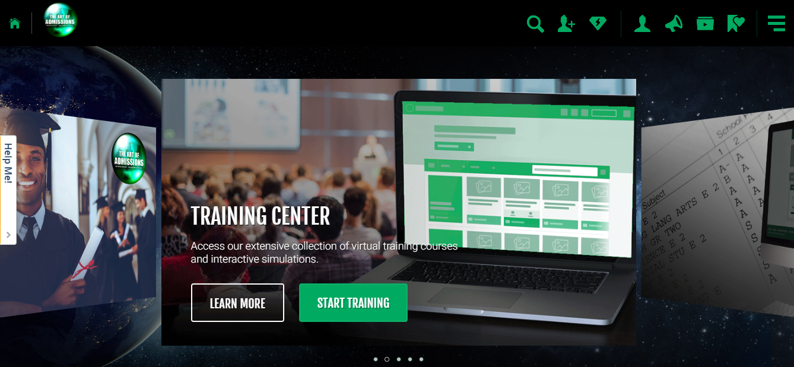
The Online Video Training Series
Intro to the platform.
Logging in
How to watch
Assessment
Tracking
Your first videos! Special Rate for Webinar Attendees
$49/Rep for This Month (Reg $350 Pe Rep per/Month)

Slide 22
Holding On To Enrolled Students Virtually
It is critical during this time to hold on to our enrollees and keep them inspired.
#1 - Create a deep, NOT surface connection using video during your initial phone call
Create a specific 2-way communication agreement
Create a checklist of what they can do to stay motivated from now until they start
Let them know the contact plan going forward:
Send (at minimum) weekly texts/emails with links to value added and inspirational videos or articles
Use Video email. (Free Subscriptions with BombBomb Video Email – www.VideoForAdmissions.com )
Create a weekly appointment time to call/video engage with them one on one at the same day and time each week. (Between 15 minutes to 30 minutes)
Create weekly online short interactive LIVE VIDEO classes via ZOOM so your new enrollees are learning every week. This is HUGE to keeping then engaged

Slide 23
Offer to Schools – Virtual Admissions Tool
Enrollment Resources is offering all current clients and non-clients our Virtual Admissions Interview and Tour tool for free during this Covid-19 crisis. No strings attached.
Also, ER is offering our VA Marketing Pathway FREE to schools for the next 60-days as a pilot to help them generate more leads during this time.
The Art of Admissions is offering free coaching and training on virtual tours and presentations. Lex@theartofadmissions.com
If your would like to set up a quick call take you through a demo and discuss how we can get this going for your school email Tom King at tom@enrollmentresources.com

Slide 24
Reach out at any time for optimizations, inspiration or coaching.
Lexington Maximus 201-953-9984
Tom King 216-577-8296

